Slide 1
Cramer’s Rule
Notes:
for x=A⁻¹b

Slide 2
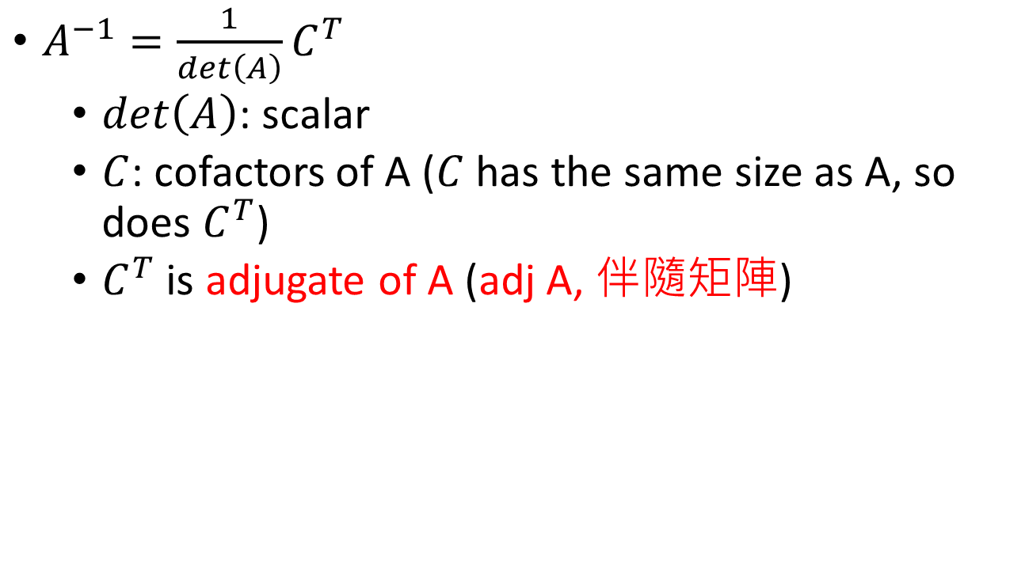
Formula for A⁻¹
$C=\left[\begin{matrix}c_{11} & ⋯ & c_{1n} \\ ⋮ & ⋱ & ⋮ \\ c_{n1} & ⋯ & c_{nn}\end{matrix}\right]$
$A^{−1}=\frac{1}{det\left(A\right)}C^{T}$
$det\left(A\right)$: scalar
$C$: cofactors of A ($C$ has the same size as A, so does $C^{T}$)
$C^{T}$ is adjugate of A (adj A, 伴隨矩陣)
$$C=\left[\begin{matrix}c_{11} & c_{12} \\ c_{21} & c_{22}\end{matrix}\right]$$
$$A=\left[\begin{matrix}a & b \\ c & d\end{matrix}\right]$$
$$A^{−1}$$
$$=\left[\begin{matrix}d & −c \\ −b & a\end{matrix}\right]$$
$$det\left(A\right)$$
$$=\frac{1}{ad−bc}\left[\begin{matrix}d & −b \\ −c & a\end{matrix}\right]$$
$$C^{T}$$
$$=\left[\begin{matrix}d & −b \\ −c & a\end{matrix}\right]$$
$$=ad−bc$$

Slide 3

Formula for A⁻¹
$$A^{−1}=\frac{1}{det\left(A\right)}C^{T}$$
$A=\left[\begin{matrix}a & b & c \\ d & e & f \\ g & h & i\end{matrix}\right], A^{−1}=$?
$$det\left(A\right)=aei+bfg+cdh−ceg−bdi−afh$$
$$+$$
$$\left|\begin{matrix}e & f \\ h & i\end{matrix}\right|$$
$$−$$
$$\left|\begin{matrix}d & f \\ g & i\end{matrix}\right|$$
$$+$$
$$\left|\begin{matrix}d & e \\ g & h\end{matrix}\right|$$
$$C=$$
$$−$$
$$\left|\begin{matrix}b & c \\ h & i\end{matrix}\right|$$
$$\left|\begin{matrix}a & c \\ g & i\end{matrix}\right|$$
$$\left|\begin{matrix}a & b \\ g & h\end{matrix}\right|$$
$$+$$
$$−$$
$$\left|\begin{matrix}b & c \\ e & f\end{matrix}\right|$$
$$\left|\begin{matrix}a & c \\ d & f\end{matrix}\right|$$
$$\left|\begin{matrix}a & b \\ d & e\end{matrix}\right|$$
$$+$$
$$−$$
$$+$$
Notes:
用手寫版吧

Slide 4
Formula for A⁻¹
$$A^{−1}=\frac{1}{det\left(A\right)}C^{T}$$
Proof: $AC^{T}=det\left(A\right)I_{n}$
$$\left[\begin{matrix}a_{11} & ⋯ & a_{1n} \\ ⋮ & ⋱ & ⋮ \\ a_{n1} & ⋯ & a_{nn}\end{matrix}\right]\left[\begin{matrix}c_{11} & ⋯ & c_{n1} \\ ⋮ & ⋱ & ⋮ \\ c_{1n} & ⋯ & c_{nn}\end{matrix}\right]=\left[\begin{matrix}det\left(A\right) & ⋯ & 0 \\ ⋮ & ⋱ & ⋮ \\ 0 & ⋯ & det\left(A\right)\end{matrix}\right]$$
transpose
Diagonal:
By definition of determinants
Not Diagonal:
(Exercise 82, P221)

Slide 5

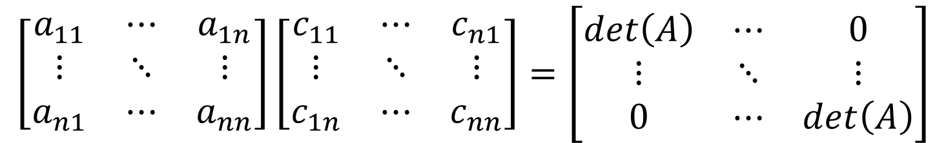

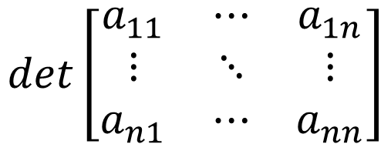
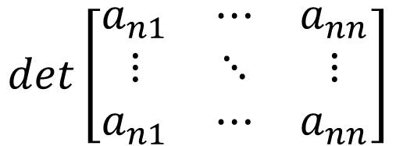
$$AC^{T}=det\left(A\right)I_{n}$$
$$\left[\begin{matrix}a_{11} & ⋯ & a_{1n} \\ ⋮ & ⋱ & ⋮ \\ a_{n1} & ⋯ & a_{nn}\end{matrix}\right]\left[\begin{matrix}c_{11} & ⋯ & c_{n1} \\ ⋮ & ⋱ & ⋮ \\ c_{1n} & ⋯ & c_{nn}\end{matrix}\right]=\left[\begin{matrix}det\left(A\right) & ⋯ & 0 \\ ⋮ & ⋱ & ⋮ \\ 0 & ⋯ & det\left(A\right)\end{matrix}\right]$$
$$det\left[\begin{matrix}a_{11} & ⋯ & a_{1n} \\ ⋮ & ⋱ & ⋮ \\ a_{n1} & ⋯ & a_{nn}\end{matrix}\right]$$
$$=a_{11}c_{11}+a_{12}c_{12}+⋯+a_{1n}c_{1n}$$
$$det\left[\begin{matrix}a_{n1} & ⋯ & a_{nn} \\ ⋮ & ⋱ & ⋮ \\ a_{n1} & ⋯ & a_{nn}\end{matrix}\right]$$
$$=a_{n1}c_{11}+a_{n2}c_{12}+⋯+a_{nn}c_{1n}$$
$$=0$$

Slide 6

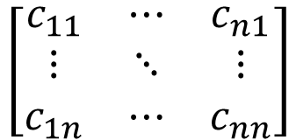

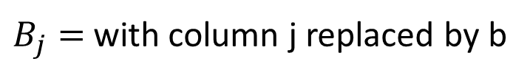
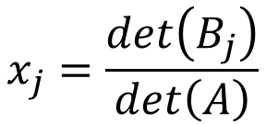
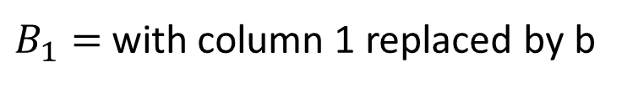
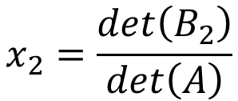
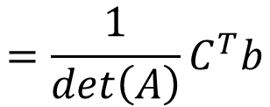

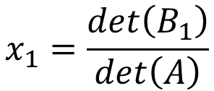

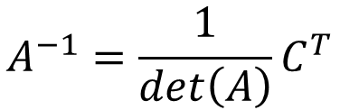
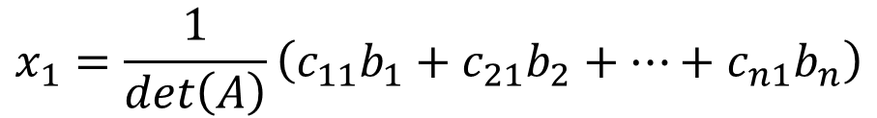
Cramer’s Rule
$$\left[\begin{matrix}c_{11} & ⋯ & c_{n1} \\ ⋮ & ⋱ & ⋮ \\ c_{1n} & ⋯ & c_{nn}\end{matrix}\right]$$
$$A^{−1}=\frac{1}{det\left(A\right)}C^{T}$$
$$=\frac{1}{det\left(A\right)}C^{T}b$$
$$Ax=b$$
$$x=A^{−1}b$$
$$x_{1}=\frac{1}{det\left(A\right)}\left(c_{11}b_{1}+c_{21}b_{2}+⋯+c_{n1}b_{n}\right)$$
$$x_{1}=\frac{det\left(B_{1}\right)}{det\left(A\right)}$$
$$det\left(B_{1}\right)$$
$B_{1}=$with column 1 replaced by b
$$x_{2}=\frac{det\left(B_{2}\right)}{det\left(A\right)}$$
n-1
Columns
of A
$$b$$
……
$$x_{j}=\frac{det\left(B_{j}\right)}{det\left(A\right)}$$
$B_{j}=$ with column j replaced by b
Notes:
$$c_{11}b_{1}+c_{21}b_{2}+⋯$$

